Slide 1
Title of Talk
Transitioning Youth with Disabilities and Employment Project:
The TYDE Project
Notes:
The TYDE Project is a collaborative interdisciplinary, cross-sectoral research network that seeks to inform policy and practice to achieve improved labour market participation of individuals with ID and/or ASD led by Dr. Rachelle Hole, Dr. Leyton Schellnert, and Dr. Steven Barnes.
The project is inclusive of UBC, school districts, community organizations, ministries of education, and family development
Goal: improving the employment outcomes of transitioning youth with intellectual disabilities (ID) and/or autism spectrum (ASD) disorder in BC.
Valuing and prioritize the inclusion of self advocates –
transitioning youth with ID and/or ASD – and
family members and caregivers in the planning and implementation of this project and
sharing of findings locally, provincially, nationally and internationally.

Slide 2
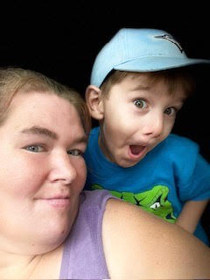
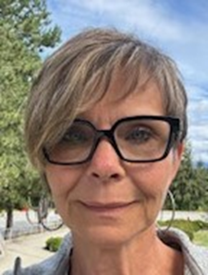
Who we are:
Tricia Lins
Sandra Polushin
TYDE Self-Advocate Research Consultant
(and her side-kick, Riley)
TYDE Research Coordinator
Notes:
I’d also like to acknowledge that we are both meeting with you from Langley, on the traditional, unceded territories of the Coast Salish Peoples, specifically the q̓ic̓əy̓ (Katzie), q̓ʷɑ:n̓ƛ̓ən̓ (Kwantlen), Máthxwi (Matsqui), and Se\'mya\'me (Semiahmoo) First Nations
We are a part of a large group led by Dr. Rachelle Hole, Dr. Leyton Schellnert, and Dr. Steven Barnes.

Slide 3
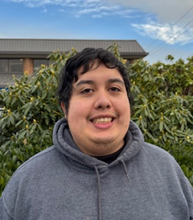
Predictors of employment outcomes:
Start Early!
Experiences of inclusion
Early work experience
Enhanced self-determination
The value and importance of parents’ role
Notes:
Start Early!
Starting early is one of the most important predictors of post-school employment outcomes!
Research consistently supports that intervening early when youth are transitioning from school to adult life can translate to positive employment outcomes (Cimera et al., 2014; Cimera et al., 2013).
Experiences of inclusion
[e.g., inclusive education; community inclusion]
Early work experience
[e.g., early paid employment, volunteer experience, post-secondary]
Enhanced self-determination
The value and importance of parents’ role

Slide 4
Overarching Learning Outcomes/ Objectives
Youth:
will create a plan for getting and maintaining meaningful employment.
develop their capacity to have a say in and make decisions about their lives and future (“nothing about us without us”).
Family members/caregivers:
will develop knowledge and skills to support the youth in creating a plan for transitioning to meaningful employment.
Notes:
You will learn about your strengths, interests, and strategies to develop personal skills and abilities that will build a foundation for future employment.

Slide 5
TYDE Structure
Notes:
The platform is structured around several key components designed to guide and support user engagement, with particular attention to accessibility and relevance (users’ age and experience within the employment process). Recognizing that youth will be at different stages, we have designed the platform and curriculum to align with those that are 1. not thinking about jobs; 2. those preparing to get a job; and 3) those that are working at a job.

Slide 6
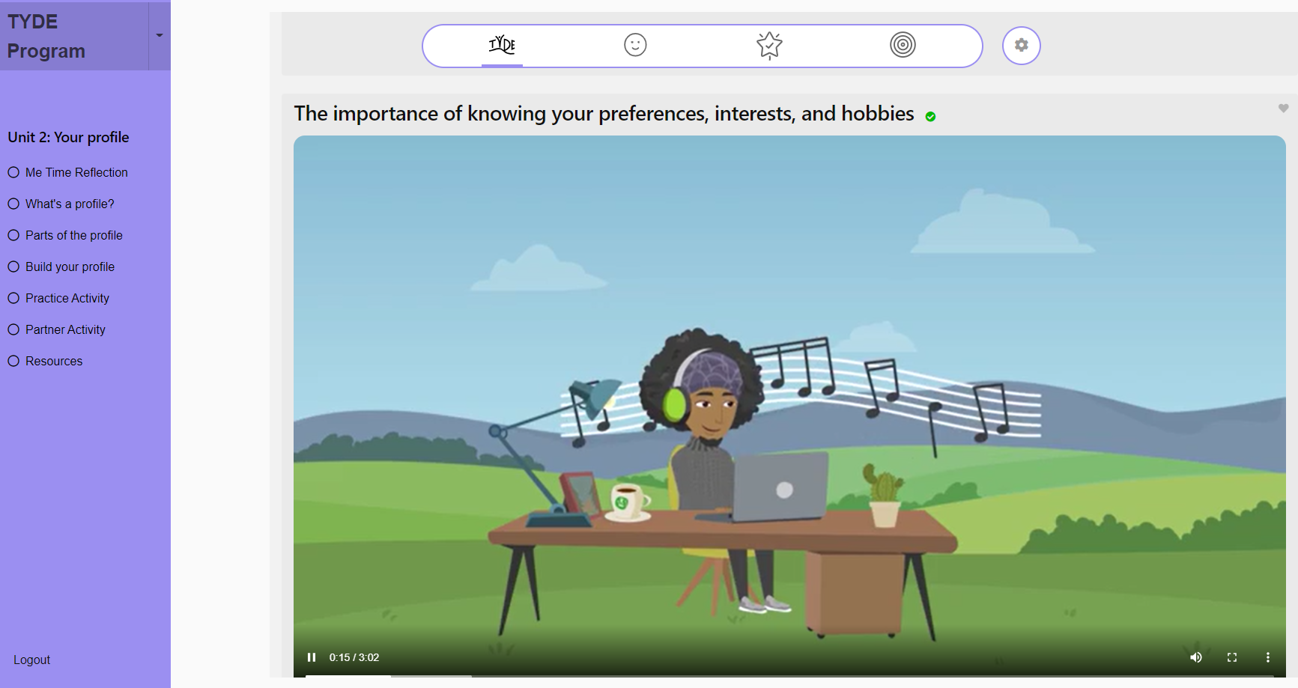
TYDE Building Your Profile
Notes:
A core activity in the program involves youth creating a personal profile as a foundational step to reflect on who they are and what matters to them most.

Slide 7
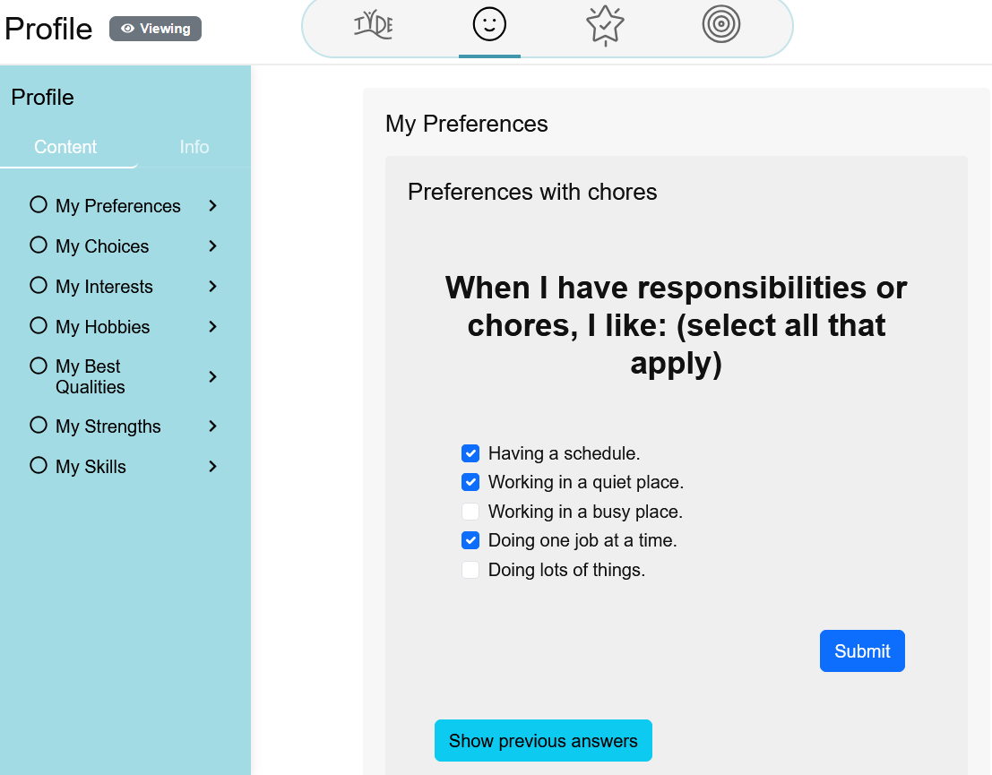
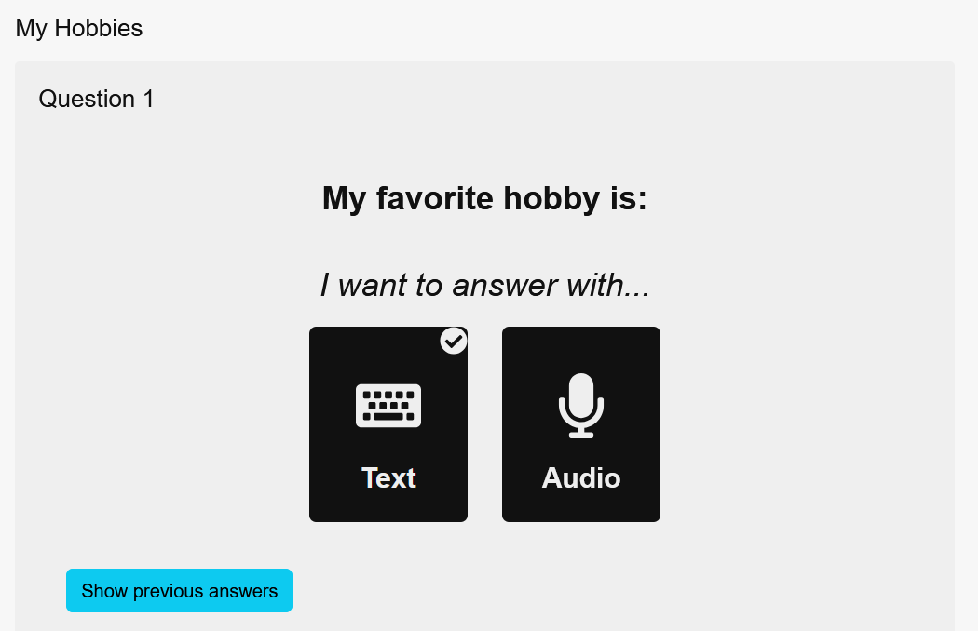
TYDE Profile
Notes:
With each question, they have the flexibility to revise or expand their responses as they gain deeper self-awareness while progressing through the modules. This process is supported by staff / caregivers and is guided by a combination of person-centred planning approaches, such as the Discovery. As you’ll note, the key domains focus on preferences, choices, interests, hobbies, best qualities, strengths, and skills.
Youth also have the option of constructing their profiles in multiple response formats, to enhance access and participation, such as selecting attributes from a checklist, typing their reflections, or recording audio responses.

Slide 8
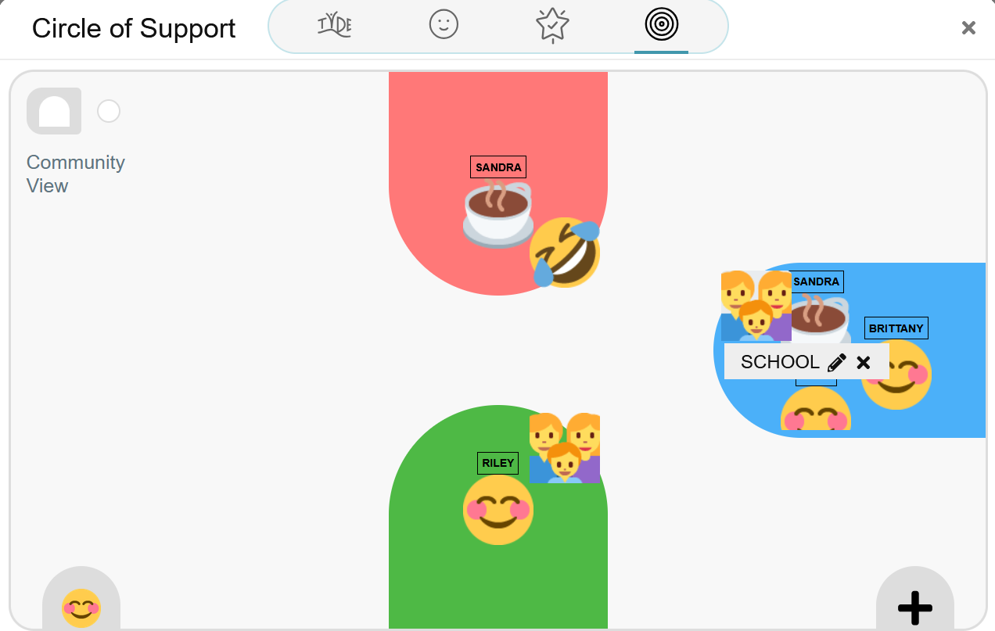
TYDE Circle of Support: Communities
Communities I belong to…and who is in them
Notes:
We know that connections to community is an important part of understanding what’s important to youth and provide clues connections in community. It also provide clues to skills and abilities they already have that can transfer to work contexts.
Hence, the next tool that we’ve embedded is a Circle of Support, which addresses the connections that youth have in their community, and then a second part which helps them to identify who is part of these communities that might be helpful in supporting their goals and aspirations.
(Note: the differences in youth’s experiences/connections.

Slide 9
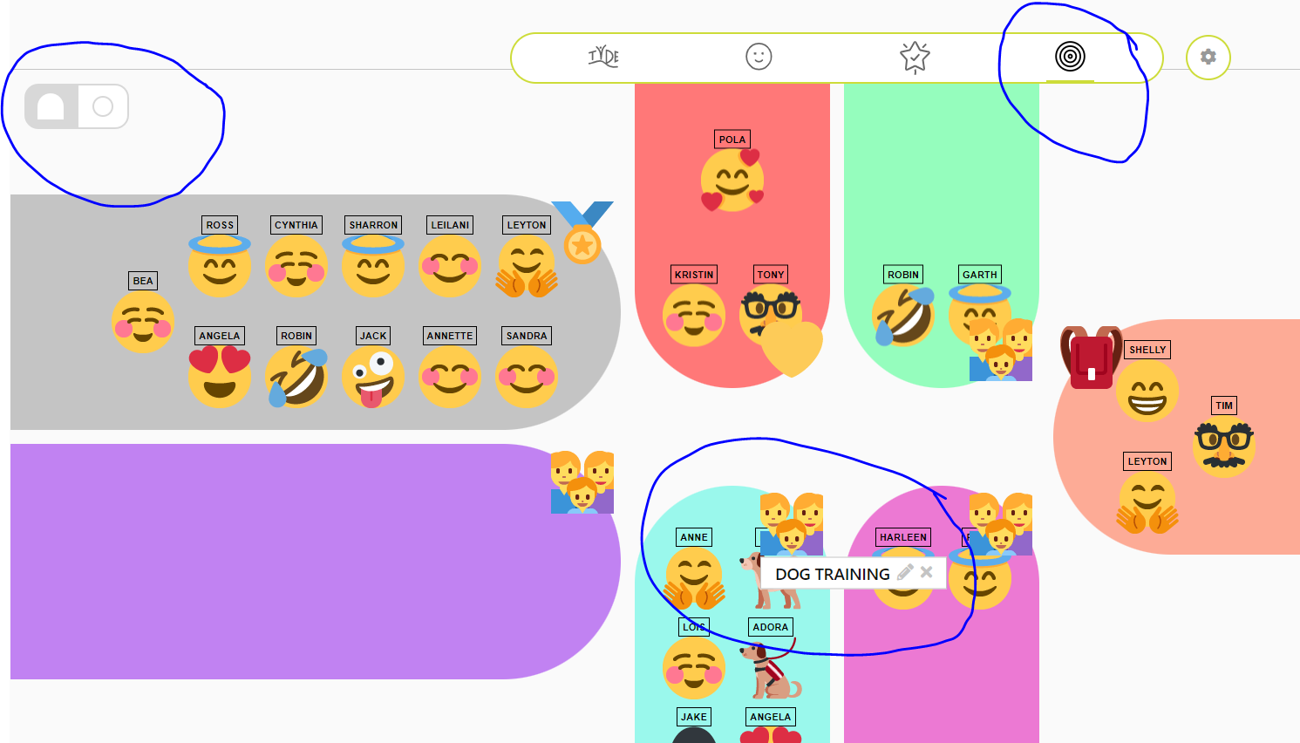
TYDE Circle of Support: Communities
Rachelle’s communities and connections

Slide 10
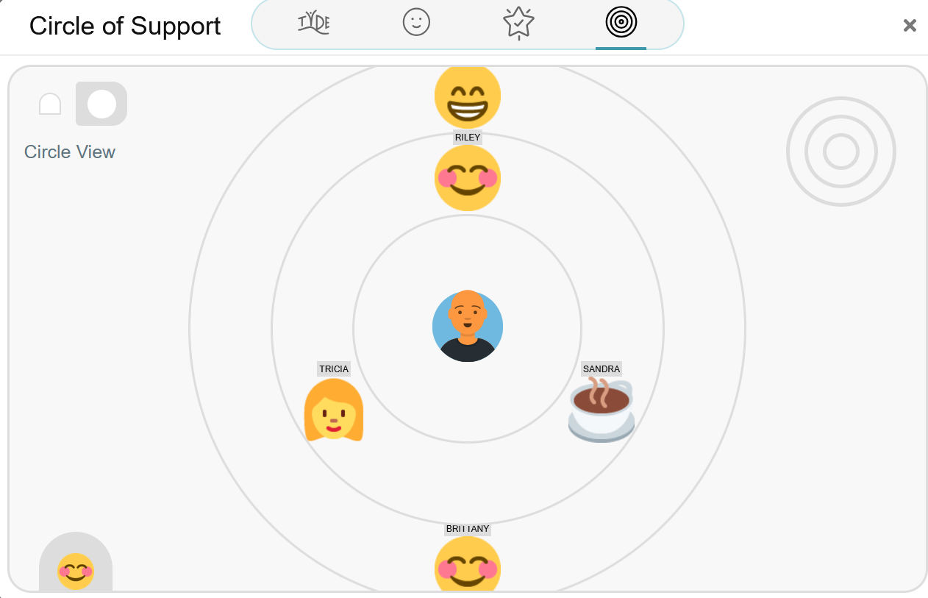
TYDE Circle of Support: Circle View
My relationships
Notes:
In each module, youth can add to their circle if they identify people they did not think of originally. Not all youth have deep connections, and so it is recommended that they build their circle over time.

Slide 11
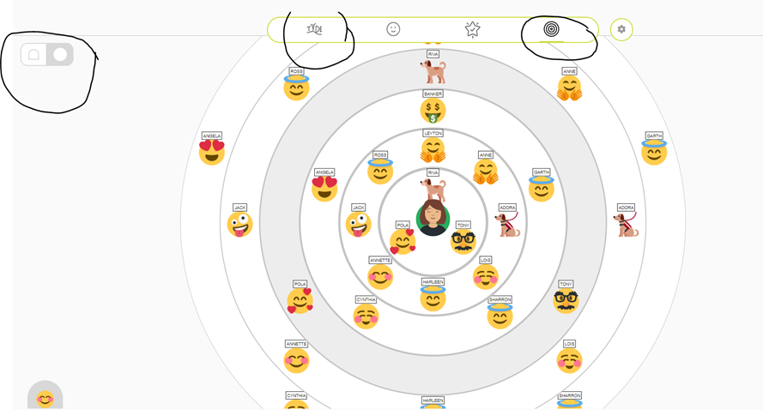
TYDE Circle of Support: Circle View
Rachelle’s relationships
Notes:
Relationship are critical in supporting youth in their employment journey and connecting them to community. We designed a Circle of Support Tool to help youth identify people in their circle that could help them in meeting their goals.
In each module, youth can add to their circle if they identify people they did not think of originally. Not all youth have deep connections, and so it is recommended that they build their circle over time.

Slide 12
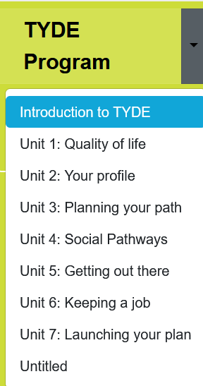
TYDE Content Video:
Notes:
The program is divided in 7 units, each video features content grounded in evidence-based research, designed to support youth in exploring their passions and uncovering a sense of purpose in life.
The videos are intentionally brief—ranging from 2 to 3 minutes in length—covering areas that support transference of skills from home / school / community…into skills/abilities/knowledge that will be helpful in employment situations. Each unit is approximately 1-2 hours in total, depending upon the youth.

Slide 13
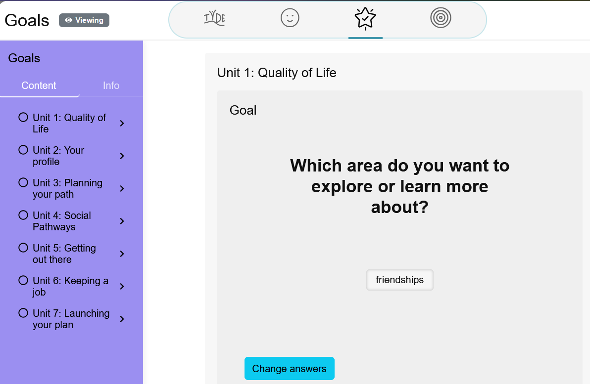
TYDE Goal Setting
Notes:
Each unit has an opportunity for the youth to set a goal. The process of setting goals challenging, so there are a set of scaffolded questions to help guide the process, while also thinking about who they can ask for help from their circle of support!

Slide 14
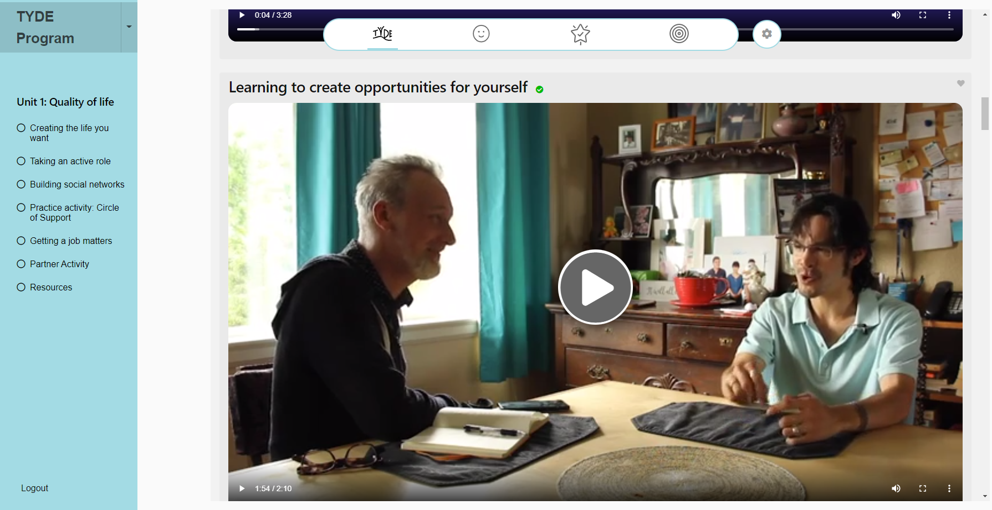
Videos with Self Advocates
Notes:
The TYDE curriculum extends beyond animated content to include video snippets featuring self-advocates sharing their lived experiences. Across cohorts, these videos have proven to be a meaningful element—helping youth envision employment as a real and attainable goal. By hearing directly from their peers, participants are exposed to valuable insights, advice, and inspiration.

Slide 15
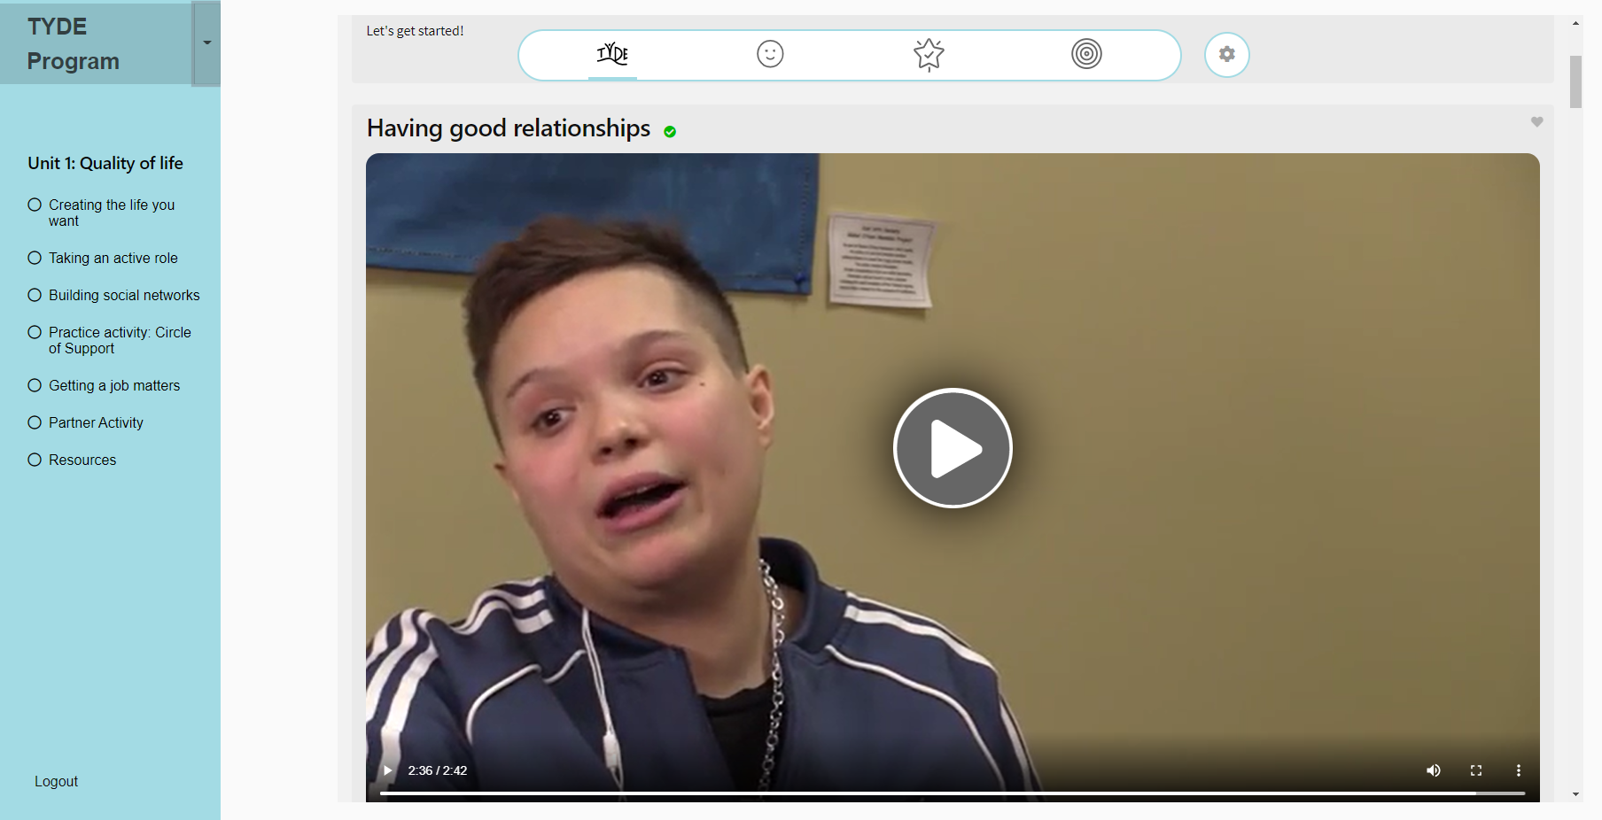
Alignment with BC Curriculum
Notes:
The TYDE curriculum has a strong alignment with the BC Curriculum to support the youth in addressing core competencies, although this was not the framework that guided the design.
For example:
Personal and Social Competency designed to support self-awareness, identity formation, and social responsibility, while youth identify their strengths, interests in a reflective and collaborative process.
Communication Competency – aspects related to self advocacy, disclosure, communication skills/abilities; Plus multiple modes of communication, from which youth could select the most relevant way to respond to questions, build their profile, set goals, and engage with their caregiver/ staff.
Thinking Competency The structure encourages critical and reflective thinking through modules such as goal setting, decision-making, and taking steps that will build upon their current strengths and areas for further development in a work context.
Career-Life Exploration & Development Youth explore pathways through interests, and skills identification, and early work experiences (if applicable)—key components of TYDE that align with Career-Life Education (CLE) and Career-Life Connections (CLC).

Slide 16
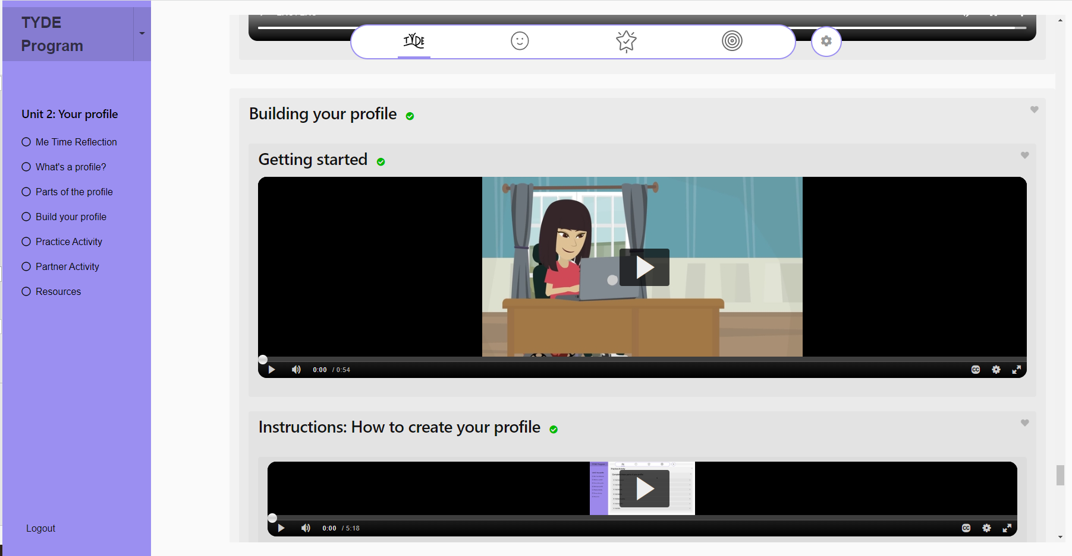
Instructional Videos
Notes:
Instructional videos are also included to support youth and their support person in building the profile and their circle of support, providing a reference when working with the profile/goals/and circle of support

Slide 17
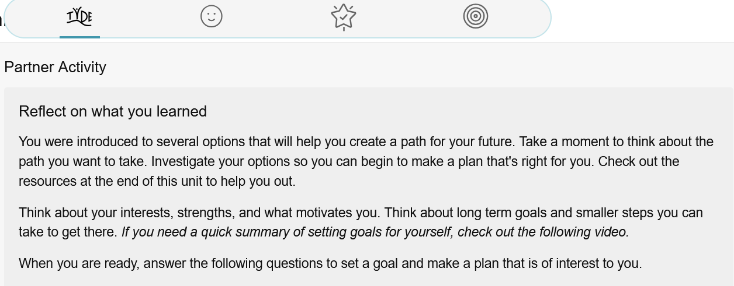
Partner Activities (Reflections on learning)
Notes:
At the end of each unit, there is an opportunity for the youth to reflect on what they have learned in the unit, and to set a goal and make plans to work on in an area that is relevant and meaningful to them.
This process is structured on reflective practice as a key skill to help support youth in thinking about what matters to them, and how they can approach it.

Slide 18
Research Components
Entrance Interview (online Qualtrics approximately 20 minutes)
TYDE Program – 7 Units completed with a partner
Average of 2 hours per unit
Partner Activities (approximately 20 minutes per unit)
Exit Interview (online Qualtrics approximately 20 minutes)
Follow-up interviews with the youth
Follow-up interviews/focus groups with the support people
Notes:
Leyton

Slide 19
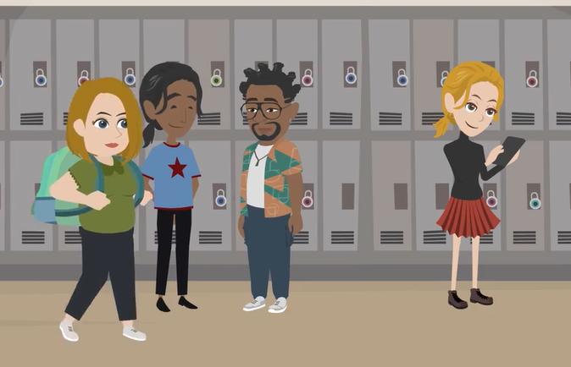
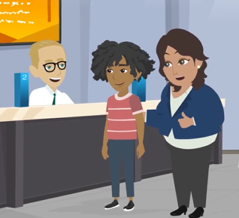
Youth with intellectual and developmental disabilities preparing for transition
Ages 14- 23
4 School Districts
Resource Teachers
Education Assistants
Career Connections teacher
(Parents/Caregivers)
5 Community Living Organizations
Community Support workers
Employment specialists
Job coaches
Notes:
Meticulon Assessment Survey (MAS, 2020)
54 participants who completed all aspects of the research / 64 who participated in total but not all did the research component

Slide 20
“I learned a lot of skills from it [TYDE]. I did learn how to communicate properly with coworkers, and I definitely learned how to keep a job for sure…It definitely did help me focus on what I need to do next because it taught me how to like properly set goals for me and like, properly. I learned what I want to do and prioritize.”
Dual Credit Student

Slide 21
“It was very impactful for the resource teachers and staff to actually see curriculum that’s actually designed with those learners in mind.
But the biggest ‘aha’ being that everyone could use this curriculum…THAT to me was a really powerful shift” (School District participant)
Notes:
4 School Districts
Resource Teachers
Education Assistants
Career Connections teacher
(Parents/Caregivers)

Slide 22
“it caused [staff] to reflect a lot on how much time we spend doing other things versus how much time we spend actually getting to know the youth themselves and giving them the opportunity to get to know themselves.”
(School District participant)
Notes:
4 School Districts
Resource Teachers
Education Assistants
Career Connections teacher
(Parents/Caregivers)

Slide 23
“Going through the goals is very helpful, especially when you do it at the end of the unit because they start getting ideas through the videos that they've watched.
For the youth that I've supported, it really helped her navigate and see what she actually wanted to do and how to complete that goal.”
(Employment Specialist | Community Living Agency)
Notes:
- Employment specialist

Slide 24
I think very highly of TYDE, I think it was very beneficial for many of my youth, and I still reference it in the material even now that I'm more focused on adult services. And I kind of wish there was a young adult version of it for those in the early to mid 20s. I think the discovery tools that TYDE has, I think would be beneficial for everyone, not just youth.
“I think in terms of transition, the one piece that's always missing is and has been for some time is the stories, because they tend to get lost…if the kids do TYDE in their school and then can come out of that with their pre-done Discovery of “who I am” (if trying to access youth services or supports through CLBC, they can say “this is the path that I want you to help me do”, they can say, “Here it is, This is the path that I want you to help me do!...So, I think that's just really, really cool. You know, I think it's awesome

Slide 25
TYDE Delivery Options
Small Group and 1:1
Partner options – Educational Assistant; Teacher; Community Living staff (employment specialists, job coaches, community support workers); Parent/Family Member
Notes:
Leyton

Slide 26
What would this look like in your context and with your students?
What do you wonder?
Notes:
LEYTON

Slide 27
TYDE Next Steps for Participation
InclusionBC Conference (presentation of findings)
Fall 2025 release of new platform.
Open-source options!
Notes:
Scaled down research component built into the resource for those that are interested in continuing to build our knowledge and practices in support youth in their transition to employment!

Slide 28
Website: www.mytyde.ca
Twitter: @TYDE_CIIC
Contacts:
Dr. Rachelle Hole
rachelle.hole@ubc.ca
Dr. Leyton Schnellert
leyton.schnellert@ubc.ca

