Slide 1
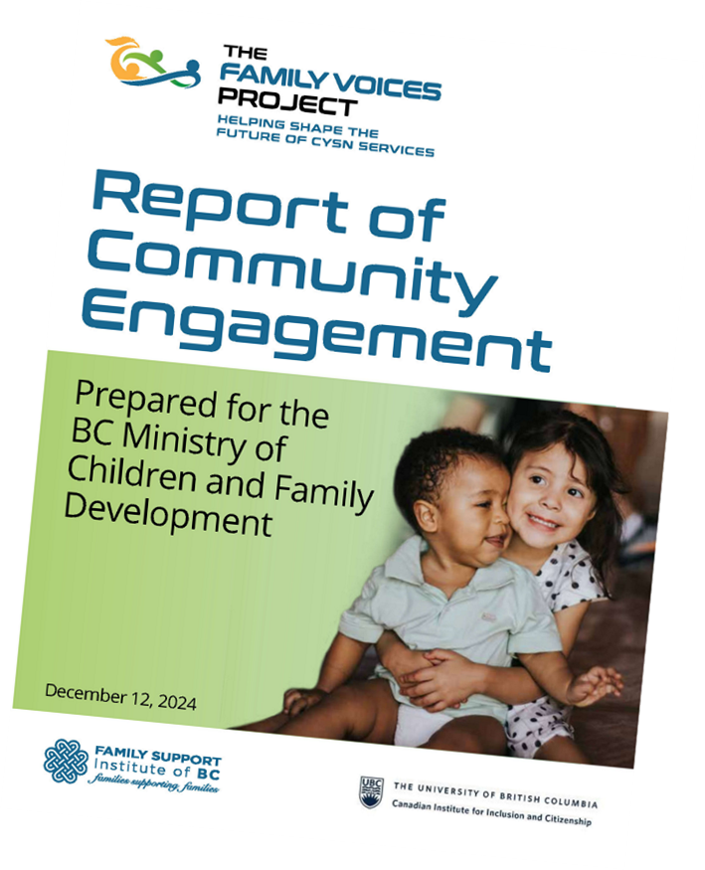
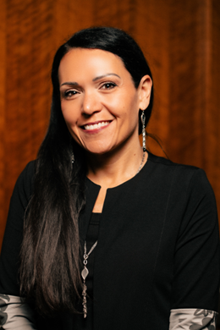
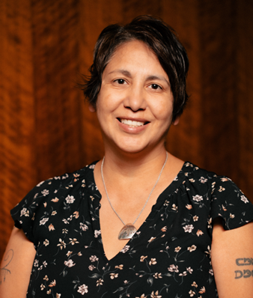
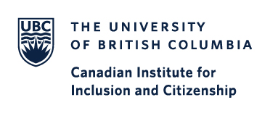
Intro
In 2024, the Family Support Institute and the CIIC collaborated to complete the Family Voices Project for MCFD. Indigenous researchers with the CIIC revisited the data using an Indigenous methodology.
Methods
Data was revisited using the Four R’s Methodology, and other related words
Themes were collected and shared between researchers to offer a representation of data grounded in Indigenous research.
Results
Many experiences are overlapping and interrelated
Despite challenges for families including colonization, systemic racism and poverty that can feel insurmountable, resiliency prevails
Transparency and communication is not optional, it is foundational
Togetherness, community, and honouring culture and language is key
Discussion
Respectful, positive, and trusting relationships are essential
Transparency and accountability is important
Listening, and learning is key
Families and Caregivers have invaluable expertise
Indigenous research methodologies are relevant to all research experiences
Dr. Rheanna Robinson, Associate Professor, UNBC, Co-Lead Indigenous Research Stream, CIIC
Sue Sterling-Bur, PhD(C), UBC-O, Co-Lead Indigenous Research Stream, CIIC
Laura Hockman, PhD Student, UBC-O, Graduate Research Assistant, CIIC
Dr. Rachelle Hole, Professor, UBC-O, Co-Director, CIIC
Using the Four R’s as Indigenous Methodology: Honouring Indigenous Philosophy in Research Analysis
Why tenets of Respect, Relevance, Reciprocity, and Responsibility (Kirkness & Barnhardt, 1992) are important in research analysis.
RELATIONSHIP
RESPECT
RECIPROCITY
RESPONSIBILTY
RELEVANCE
Embedding principles of Indigenous Knowledge amplifies the relatedness of shared experiences and highlights how the tenets of philosophes like the Four Rs have a valid and meaningful place within academic research and beyond.
Scan for more information

